Slide 1


Weekly Meeting : 17
Ahmad Agus Widodo
PhD Student in Geotechnics Sections
Department of Civil and Environmental Engineering
Supervisors:
Dr Truong Le (Geotechnic Sections)
Dr Philippa J Mason (Royal School of Mines)
This PhD is funded by Indonesian Endowment Funds for Education (LPDP)

Slide 2
Outline
01
Learning From Handbook
02

Slide 3
Learning from Previous Developed Methods
PointNet: Deep Learning on Point Sets for 3D Classification and Segmentation
LiDAR Automatic Unsupervised Segmentation using Segment-Anything Model (SAM) from Meta AI
KPConv: Flexible and Deformable Convolution for Point Clouds

Slide 4
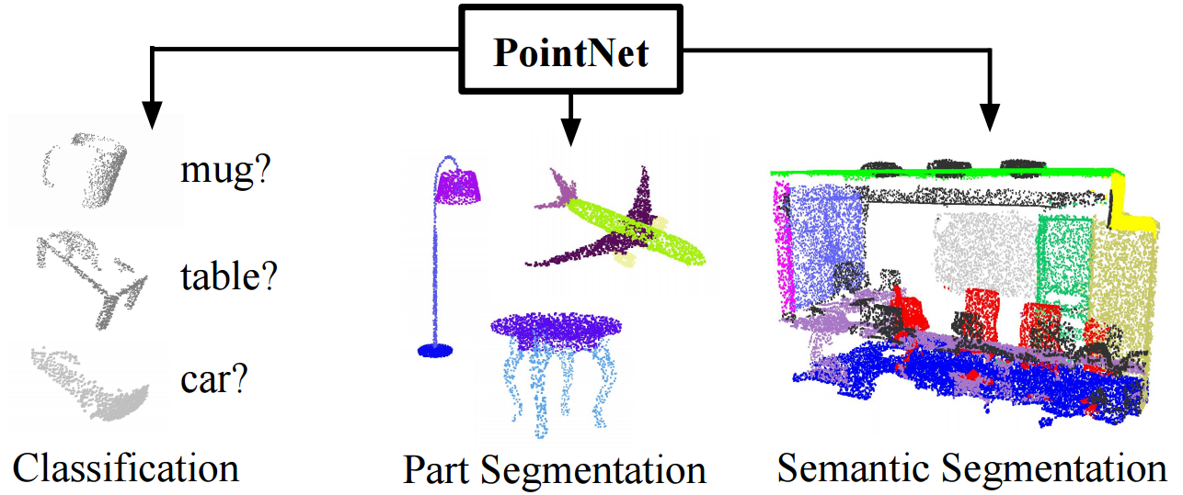
Pointnet
Result:
Github :
charlesq34/pointnet2: PointNet++: Deep Hierarchical Feature Learning on Point Sets in a Metric Space (github.com)
Keywords:
Tensorflow
The method can be applied for part segmentation and semantic segmentation to classify objects
The paper indicates that performance saturates around 1K points, suggesting a potential limitation in dealing with very large point sets.

Slide 5
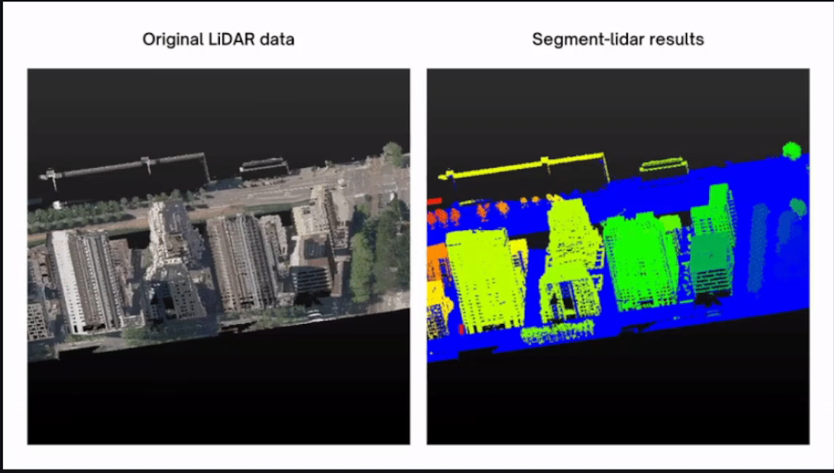
Segment Lidar
Result:
Github :
Yarroudh/segment-lidar: Python package for segmenting LiDAR data using Segment-Anything Model (SAM) from Meta AI. (github.com)
Keywords:
Pytorch
There is no paper found for this method

Slide 6
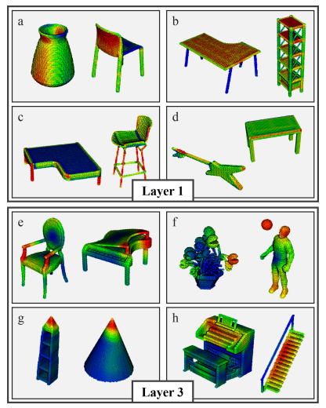
KP Conv
Result:
Github :
HuguesTHOMAS/KPConv-PyTorch: Kernel Point Convolution implemented in PyTorch (github.com)
Keywords:
Pytorch
RGB Datasets
Indoor application

Slide 7
Future Direction
Segmentation process can work properly after labelling the data
Labelling process includes acquiring the datasets from ground occurrence
It is necessary find point cloud datasets containing information of landslide along embankment system

